Slide 1
A Major project Seminar on CREDIT COIN: A PRIVACY PRESERVING BLOCKCHAIN BASED INCENTIVE ANNOUNCEMENT NETWORK FOR SMART VEHICLE COMMMUNICATION
TEAM DETAILS:
P.JAYANTH GANESH (21EG505808)
D.DEEPAK NAYAK (21EG505813)
L.PRANEETH KUMAR (21EG505844)
PROJECT SUPERVISOR :
RAGHAVENDRA KULKARNI
ASSISTANT PROFESSOR

Slide 2
INTRODUCTION
Credit Coin is a new blockchain project that combines privacy technology with smart vehicle communication. It focuses on keeping user data private while encouraging active user involvement through a blockchain-based reward system. The project aims to create a simple and effective announcement network for smart vehicles. It includes essential elements like a specialized blockchain, advanced privacy tools, and a straightforward token system. With applications in traffic management, fleet logistics, and safety improvement, Credit Coin is set to transform secure and rewarding interactions among smart vehicles

Slide 3
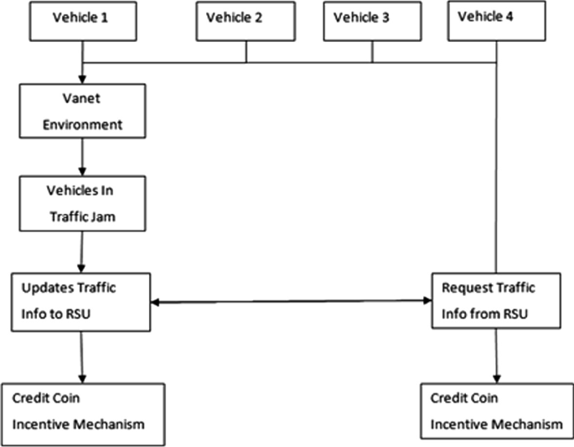
CONCEPT TREE

Slide 4
LITERATURES
AUTHOR(S) | METHOD | ADVANTAGES | DISADVANTAGES
Smith, J. | Anonymous Announcement Aggregation | 1.Enables anonymous forwarding of announcements. 2. Maintains user privacy during information sharing. | 1.Scalability challenges. 2. Complexity in implementation.
Johnson, A | CreditCoin: Incentive Framework | 1.Motivates users to share traffic information. 2.Achieves tamper-resistant transactions | 1.Potential for transaction bottlenecks 2. Overhead in incentive distribution.

Slide 5
LITERATURES
AUTHOR(S) | METHODS | ADVANTAGES | DISADVANTAGES
Li et al | Investigation of tamper-resistance and decentralization properties. | 1.Enhanced security through tamper-resistant data storage. 2.Decentralized architecture for improved reliability | 1. Potential scalability challenges in large VANETs 2. Need for standardized protocols for blockchain implementation
Liu and Cheng | Comparison of existing privacy-preserving solutions in VANETs | 1.Identification of strengths and weaknesses in privacy-preserving methods. 2. Insights into the challenges of heavy workloads in existing solutions. | 1. Lack of strong incentives for message forwarding in current approaches

Slide 6
PROBLEM STATEMENT
The current landscape of smart vehicle communication, existing methods lack sufficient privacy measures and fail to provide adequate incentives for user participation. Traditional announcement networks face vulnerabilities, leading to security concerns and inefficiencies. The Credit Coin project addresses these challenges by introducing a privacy-preserving blockchain, an incentive mechanism, and an efficient announcement network.
EXISTING METHODS AND DISADVANTAGES:
1.Centralized Communication Networks:
2. Incentive-Less Participation:
3.Unsecured Announcement Networks:

Slide 7
PROPOSED METHOD
We propose an effective announcement network called CreditCoin, a privacy-preserving incentive announcement network based on Blockchain via an efficient anonymous vehicular announcement aggregation protocol. On the one hand, CreditCoin allows non deterministic different signers to generate the signatures and to send announcements anonymously in the non fully trusted environment. On the other hand, with Blockchain, CreditCoin motivates users with incentives to share traffic information.
We design an incentive mechanism based on Blockchain in CreditCoin. Users manage reputation points while they earn or spend coins as incentives. Meanwhile, CreditCoin still preserves privacy and achieves anonymity. Moreover, based on Blockchain, CreditCoin prevents many security attacks and achieves conditional privacy because Trace manager will trace malicious nodes when an unexpected event occurs. In addition, transactions and account information in CreditCoin are tamper-resistant.

Slide 8
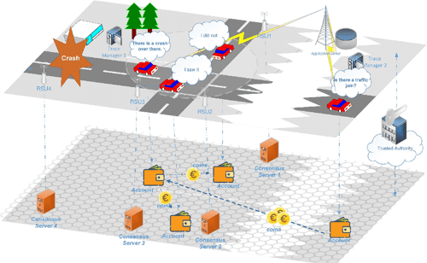
PROPOSED METHOD ILLUSTRATION

Slide 9
PARAMETER
PARAMETERS CONSIDERING:
USER ENGAGEMENT(UE) = Number of Active Users / Total User Base * 100
Privacy Score (PS) = Number of Secure Transactions / Total Transactions * 100
Incentive Efficiency (IE) =Total Tokens Distributed / Total User Contributions
Announcement Network Reliability(ANR) : Number of Successful Announcements/Total Announcements Sent *100

Slide 10
EXPERIMENT ENVIRONMENT
TOOLS:
REMIX IDE
VS CODE
ETHEREUM
LANGUAGES:
PYTHON
SOLIDITY
DATASET : Data from the dataset is employed to simulate and test various scenarios, including smart vehicle communication, privacy-preserving techniques, and the functionality of the incentive mechanism.

Slide 11
PROJECT STATUS
S.No | Functionality | Status (Completed /in-progress/Not started)
1 | Research paper collection | Completed
2 | Dataset collection | In-progress
3 | Training | Not Started

Slide 12
REFERENCES
[1] L. Chen, S.-L. Ng, and G. Wang, “Threshold anonymous announcement in VANETs,” IEEE J. Sel. Areas Commun., vol. 29, no. 3, pp. 605–615, Mar. 2011.
[2] J. Shao, X. Lin, R. Lu, and C. Zuo, “A threshold anonymous authentication protocol for VANETs,” IEEE Trans. Veh. Technol., vol. 65, no. 3, pp. 1711–1720, Mar. 2016.
[3] S. Nakamoto. (2008). Bitcoin: A Peer-to-Peer Electronic Cash System. [Online]. Available: https://bitcoin.org/bitcoin.pdf
[4] H. Hartenstein and L. P. Laberteaux, “A tutorial survey on vehicular ad hoc networks,” IEEE Commun. Mag., vol. 46, no. 6, pp. 164–171, Jun. 2008.
[5] B. Parno and A. Perrig, “Challenges in securing vehicular networks,” in Proc. Workshop Hot Topics Netw. (HotNets-IV), MD, USA, Nov. 2005, pp. 1–6.
[6] F. Dötzer, “Privacy issues in vehicular ad hoc networks,” in Proc. Int. Workshop Privacy Enhancing Technol., May 2005, pp. 197–209.

Slide 13
THANK YOU

